Slide 1
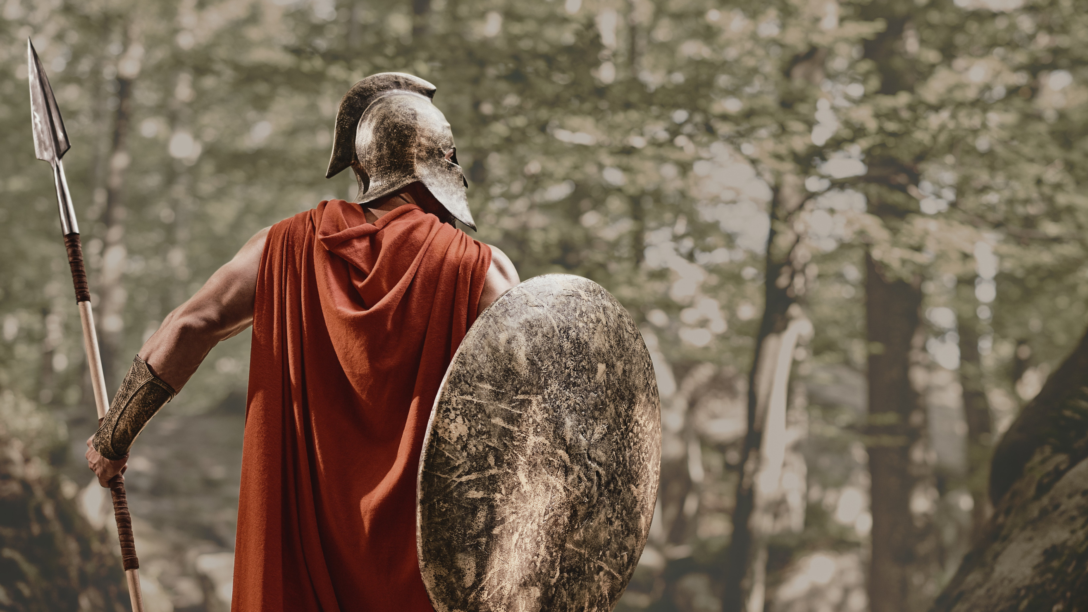
PATIENT PRAYER WARRIOR
Ephesians 6:10-18

